Slide 1
Why is Social Justice Important?
Social Justice Unit- Terms to Know

Slide 2
In Your Writer’s Notebook
•What do you believe the term social means? Give examples to help your explanation.
•What do you believe the term justice means? Give examples to help your explanation.
•When you’re finished writing the definitions for each word, write what you believe the term social justice means. Give examples to help your explanation.
Don’t panic if you do not know an exact answer. Write your opinion of what you think or where you might have heard the terms.
Be sure to write in complete sentences.

Slide 3
Social Justice definition
Social justice is a human right.
Social justice means to have the equal supply of wealth, opportunities, privileges in our society.

Slide 4
Your Assignment Part 1
The following slides have specific terms with definitions that you will need to know for our Social Justice Unit.
You will be taking notes on each of the terms. First, you will want to read through the defnition. Second, you will want to write the definition in your own words. **If you do not know the meaning of a word in the defintion, look it up in the dictionary to help you better understand the meaning.
Lastly, after you have read through and defined each term in your own words, you and your partner should come up with one or two examples for each term.

Slide 5
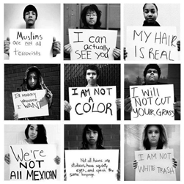
Stereotypes
•These are making generalizations about a group of people and placing the whole group into a specific category (defined set of characteristics to this group.)
Example- Assuming someone who wears glasses is a nerd or smart

Slide 6
Prejudice
Being biased or having a belief or attitude formed beforehand.
There is a judgment or opinion formed before the facts are known, which stems from stereotypes.
Example- Having a negative attitude towards all Christian people because you heard something bad on the news.

Slide 7
Discrimination
•This is the unfair treatment of a person or a group based on class or category, such as: gender, race, culture, religion, age, etc.
Example- Claire Foy, the lead actress from The Crown, made less than her male co-star.

Slide 8
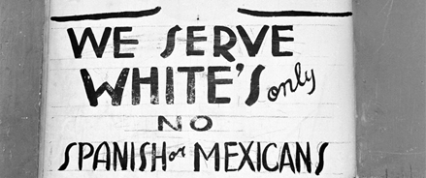
Racism
•is the hatred of one person by another -- or the belief that another person is less than human -- because of skin color, language, customs, place of birth or any factor that supposedly reveals the basic nature of that person, the "race" of that person.
Example- The Ku Klux Klan

Slide 9
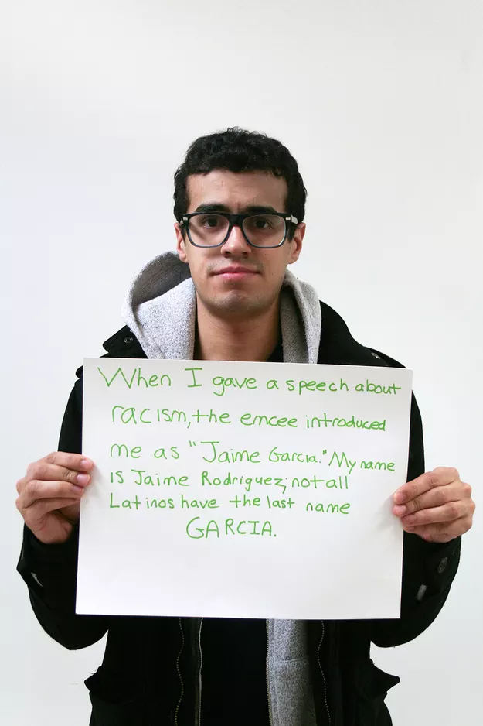
Microaggression
Is commonplace verbal or behavior indignities whether intentional or unintentional, which communicate a hostile, derogatory, or negative racial slights or insults.
Example- Asking someone who isn’t white “where are you really from?”

Slide 10
Your Assignment Part 2
Now that you have an understanding of each term, you and your partner will research current examples of social injustices in our world.
Find three or more examples by searching on the internet. Be mindful of your search words. Try google “news” search.
Summarize what happened, describe who was involved, explain what type of social injustice it is an example of.
Cite your sources.

